Slide 1
Prahari - AML Application
Team sunrisers

Slide 2
Agenda
Problem Statement
Solution
Application Workflow
Technology Stack
Architecture
Conclusion
Future Scope

Slide 3
Problem Statement
The core of the problem lies in the nature of non-custodial wallets. Unlike a traditional bank account or a custodial crypto wallet managed by an exchange, a non-custodial wallet gives the user complete control over their private keys. This means there's no third party—like a bank or crypto exchange—to monitor transactions, enforce compliance, or freeze funds. This lack of a central authority, while a key feature of decentralized finance, also creates a loophole for criminals.

Slide 4
Solution
Objective: To analyze financial transactions for suspicious activity using a microservices architecture and record legitimate transactions on a blockchain.
Core Components & Technology:
Client App (React): User-facing interface for submitting a transaction along with its CSV history (sender, receiver, amount, timestamp).
AML Service (Flask): The central analysis engine.
Receives data and determines if a transaction is suspicious.
Statistical analytics on the transaction history and inputs.
Generates forensic reports for flagged activities.
Oracle Service (Express): The blockchain gateway.
Receives non-flagged transactions from the AML service.
Uses Cosmos SDK to store the transaction on-chain.

Slide 5
Application workflow
Submission: A user submits a transaction through the React client.
Analysis: The Flask AML service screens the transaction for red flags.
Decision & Action:
FLAGGED: A forensic report is generated explaining the reason.
CLEARED: The transaction is forwarded to the Express Oracle service.
Recording: The Oracle service records the cleared transaction on the blockchain.

Slide 6
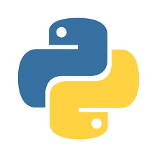










Technology Stack

Slide 7
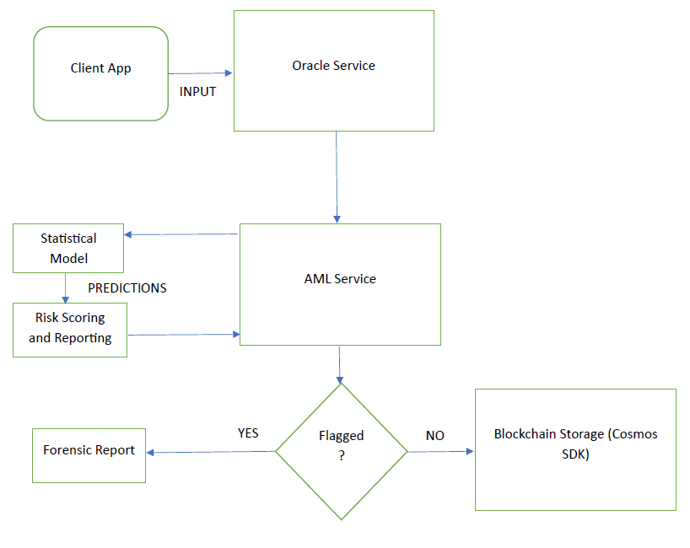
Architecture

Slide 8
Conclusion
The project successfully establishes a proof-of-concept for a modern Anti-Money Laundering (AML) system by integrating a web-based user interface with a robust backend and a decentralized ledger. It effectively demonstrates a complete, end-to-end transaction processing pipeline: from user submission via a React client, through a crucial analysis phase in a Python/Flask service, to final, immutable storage on a Cosmos SDK-based blockchain via an Express.js oracle. The architecture is modular and clearly defines the separation of concerns, showcasing a practical application of microservices in the FinTech and compliance domain.

Slide 9
Future Scope
Complete the Client Application: The immediate next step is to fully implement the React client app, which is currently a placeholder, to enable a seamless user experience for transaction submission.
Enhance AML Logic: The core AML detection logic in the Python service can be significantly upgraded. This could involve integrating advanced machine learning models for anomaly detection, incorporating more complex rule-based systems, and connecting to external APIs for real-time risk scoring.
Develop Smart Contracts: The blockchain layer can be expanded by developing sophisticated CosmWasm smart contracts written in Rust. These contracts could automate compliance actions, manage decentralized identity (DID) for users, or create transparent audit trails.
Real-time Processing: Implement a real-time data streaming pipeline using technologies like Kafka or RabbitMQ. This would allow the AML service to analyze transactions as they occur, rather than relying on batch CSV uploads.
Security and Scalability: For a production environment, focus should be placed on securing the APIs, implementing robust authentication/authorization mechanisms (like OAuth 2.0), and containerizing the services using Docker and Kubernetes for better scalability and management.

Slide 10
Thank You

